Slide 1

Visualization tool Merino clothing products

Slide 2
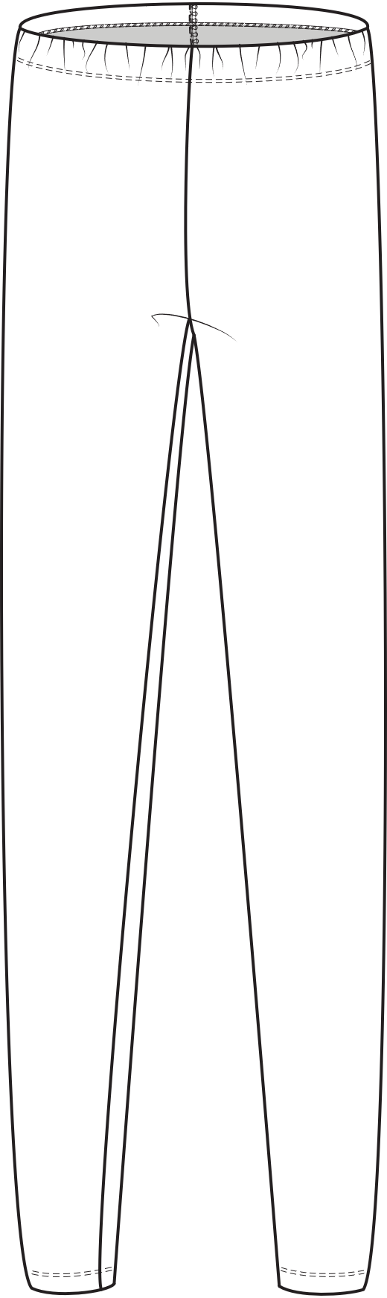
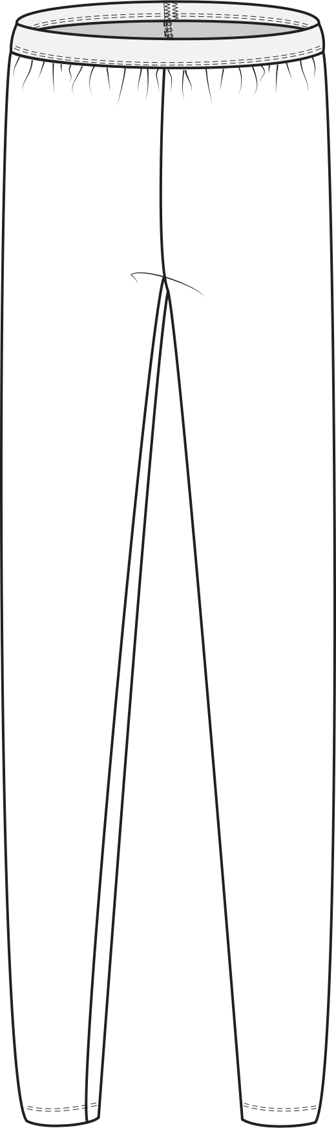
Product 1
Merino Leggings 1_0
Merino Leggings 2_0
Pattern pieces
Women + Men
Main:
1 piece
Sewing instrcutions:
Start pages 1-4
Sewing pages 5-9
File: Sewing instructions_products_Sample package 1 and
Sewing instructions_products_Simple pants_Merino wool
Pattern pieces
Women + Men
Main:
1 piece
Sewing instrcutions:
Start pages 1-4
Sewing pages 5-9
File: Sewing instructions_products_Sample package 1 and
Sewing instructions_products_Simple pants_Merino wool

Slide 3
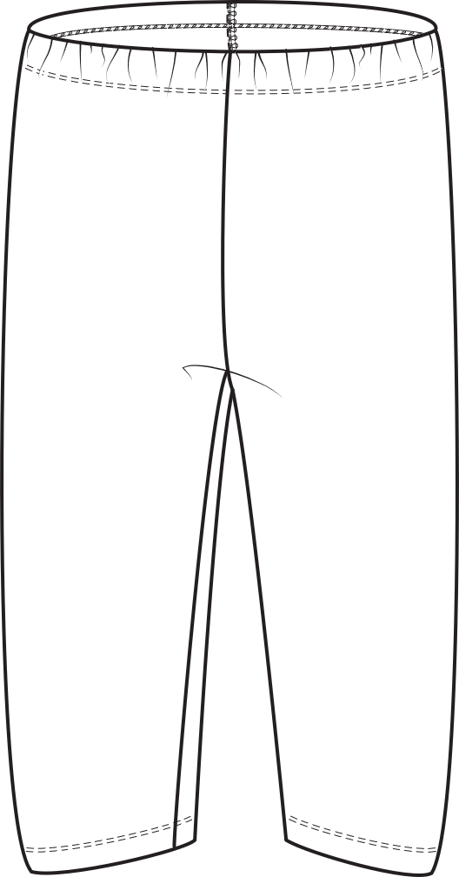
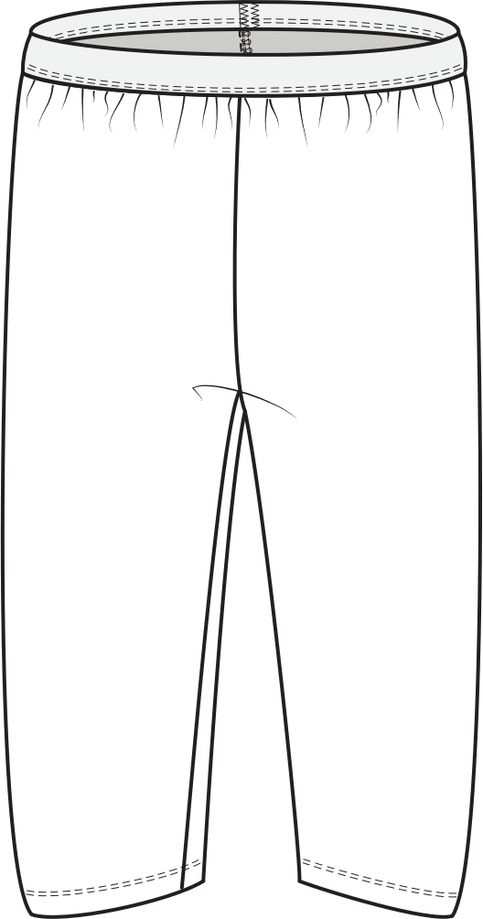
Product 2
Merino Bermudas 1_0
Merino Bermudas 2_0
Pattern pieces
Women + Men
Main:
1 piece
Sewing instrcutions:
Start pages 1-4
Sewing pages 5-9
File: Sewing instructions_products_Simple pants_Merino wool
Pattern pieces
Men + women
Main:
1 piece
Sewing instrcutions:
Start pages 1-4
Sewing pages 5-9
File: Sewing instructions_products_ Simple pants_Merino wool

Slide 4
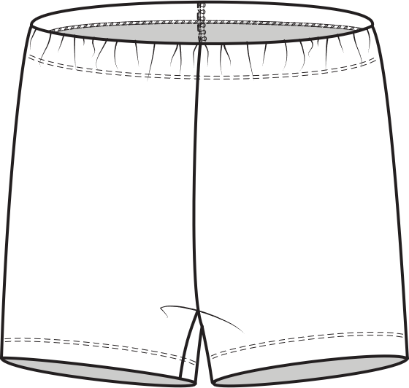
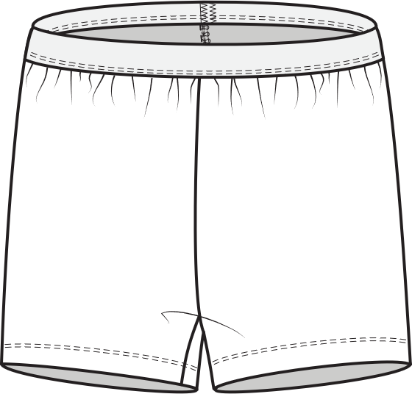
Product 3
Merino Shorts 1_0
Merino Shorts 2_0
Pattern pieces
Women + Men
Main:
1 piece
Sewing instrcutions:
Start pages 1-4
Sewing pages 5-9
File: Sewing instructions_products_Sample package 1 and
Sewing instructions_products_Simple pants_Merino wool
Pattern pieces
Women + Men
Main:
1 piece
Sewing instrcutions:
Start pages 1-4
Sewing pages 5-9
File: Sewing instructions_products_Sample package 1 and
Sewing instructions_products_Simple pants_Merino wool

Slide 5
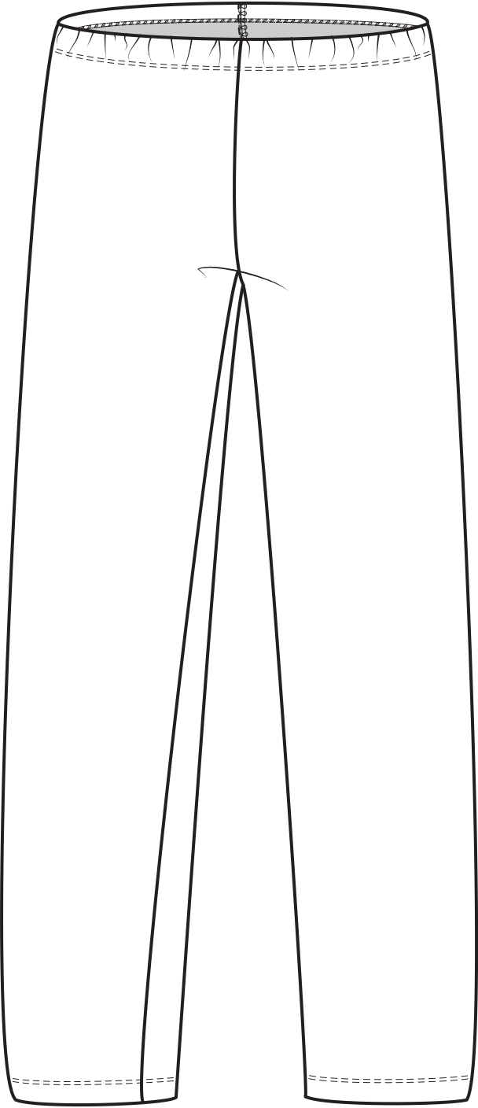
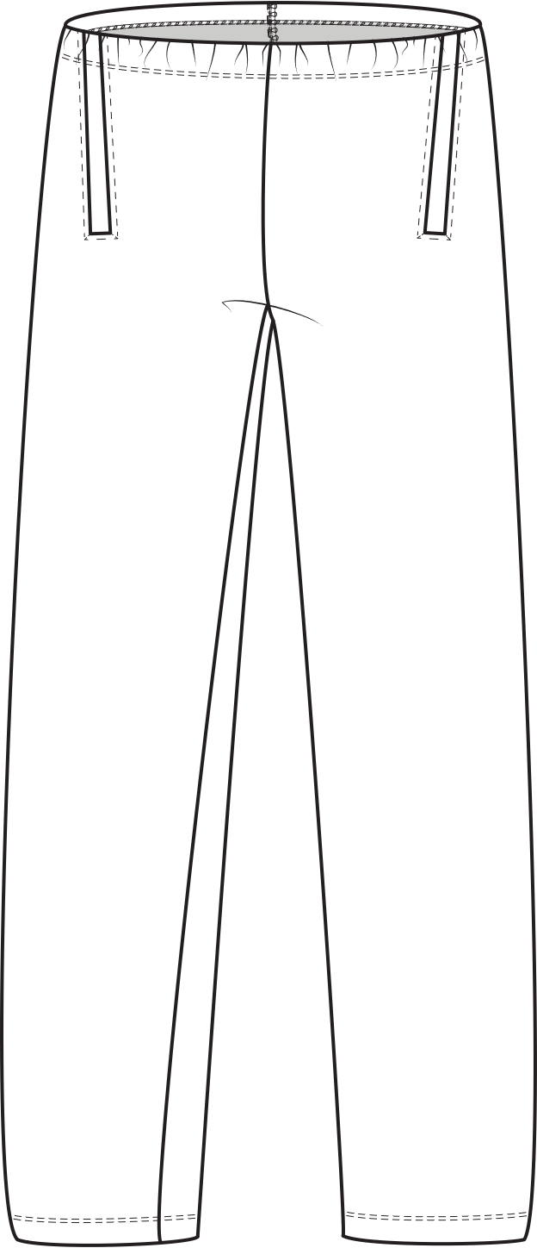
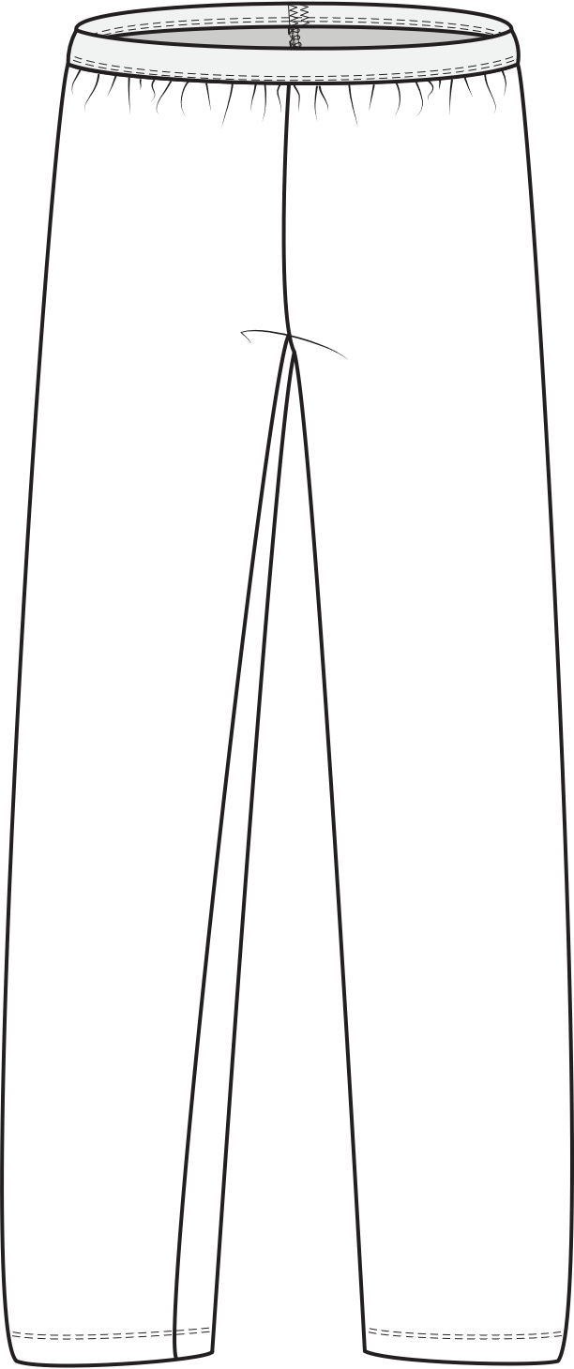
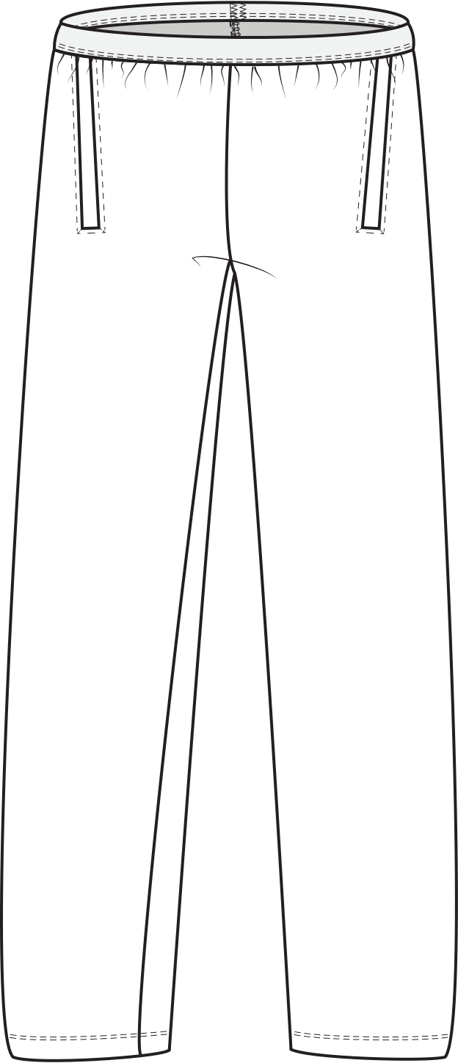
Product 4
Merino Pants 1_0
Merino Pants 1_1
Merino Pants 2_0
Merino Pants 2_1
Women + Men
Pattern pieces
Main:
Merino Pants 1_0: 1 pieces
Sewing instrcutions:
Start pages 1-4
Sewing pages 5-9
File: Sewing instructions_products_Sample package 1 and
Sewing instructions_products_Simple pants_Merino wool
Women + Men
Pattern pieces
Main:
Merino Pants 1_0: 3 pieces
Sewing instrcutions:
Start pages 1-4
Sewing pages 5-10
File: Sewing instructions_products_Sample package 1 and
Sewing instructions_products_Simple pants_Merino wool
Women + Men
Pattern pieces
Main:
Merino Pants 1_0: 1 pieces
Sewing instrcutions:
Start pages 1-4
Sewing pages 5-9
File: Sewing instructions_products_Sample package 1 and
Sewing instructions_products_Simple pants_Merino wool
Women + Men
Pattern pieces
Main:
Merino Pants 1_0: 3 pieces
Sewing instrcutions:
Start pages 1-4
Sewing pages 5-10
File: Sewing instructions_products_Sample package 1 and
Sewing instructions_products_Simple pants_Merino wool

Slide 6
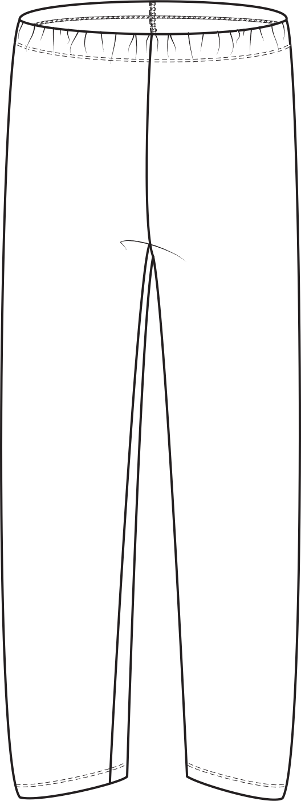
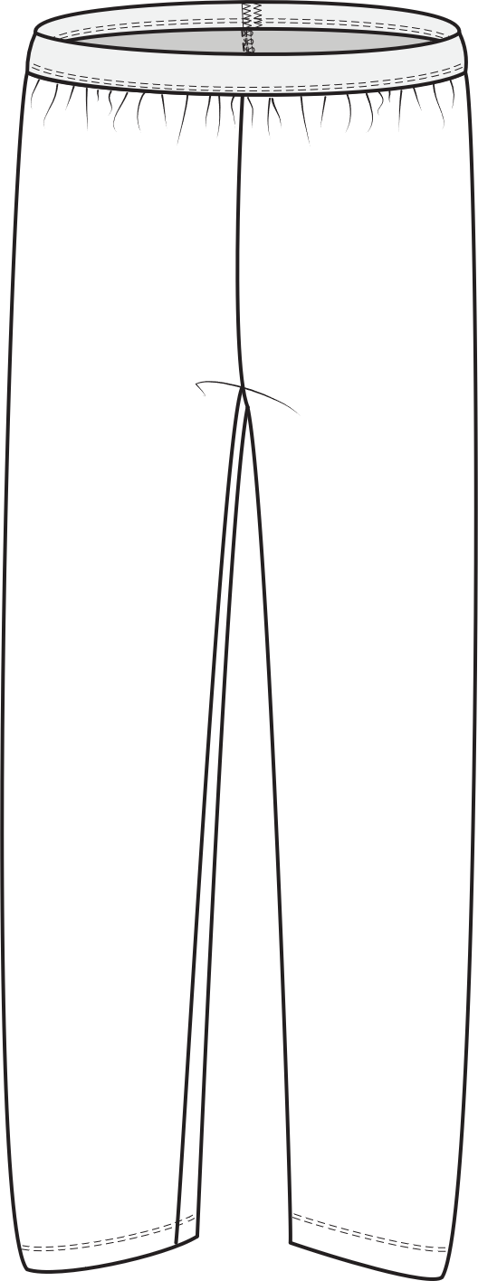
Product 5
Merino leggings half calf 1_0
Merino leggings half calf 2_0
Pattern pieces
Women + Men
Main:
1 piece
Sewing instrcutions:
Start pages 1-4
Sewing pages 5-9
File: Sewing instructions_products_Sample package 1 and
Sewing instructions_products_Simple pants_Merino wool
Pattern pieces
Women + Men
Main:
1 piece
Sewing instrcutions:
Start pages 1-4
Sewing pages 5-9
File: Sewing instructions_products_Sample package 1 and
Sewing instructions_products_Simple pants_Merino wool

Slide 7
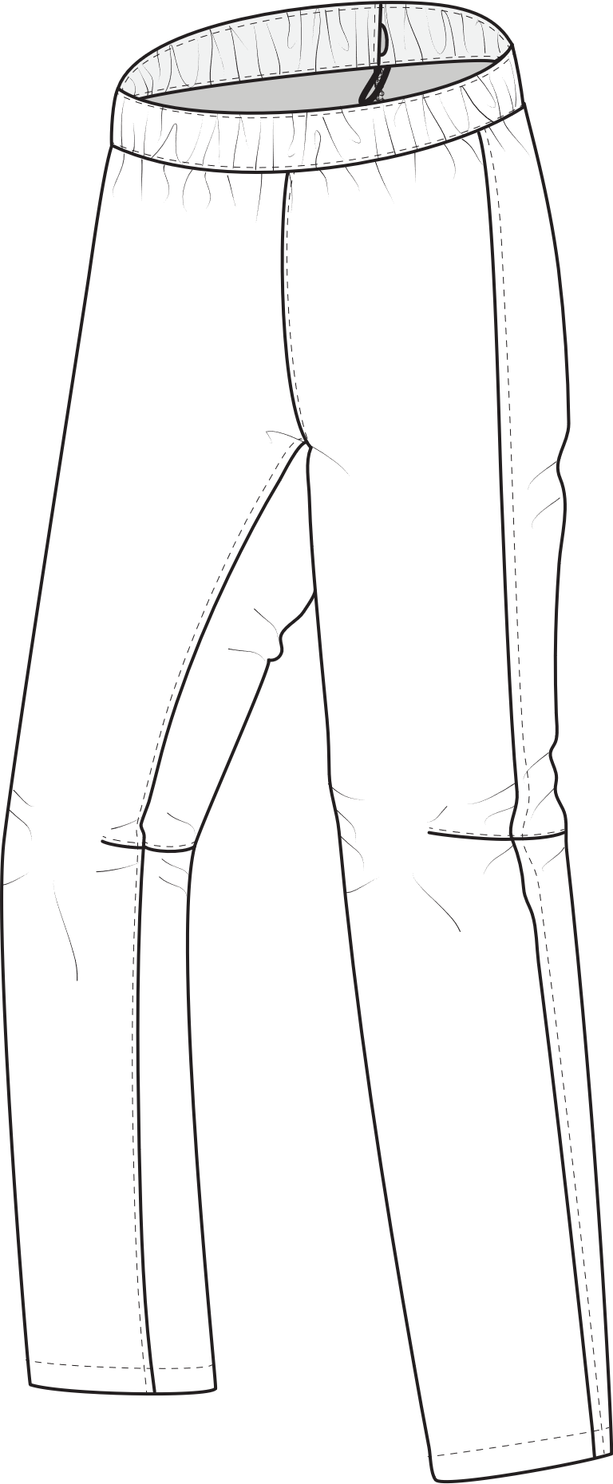
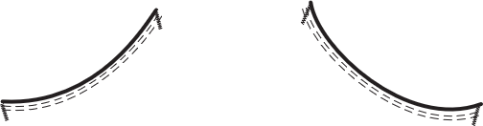
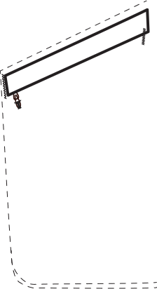
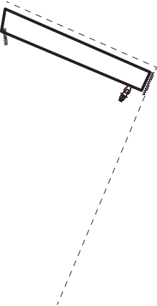
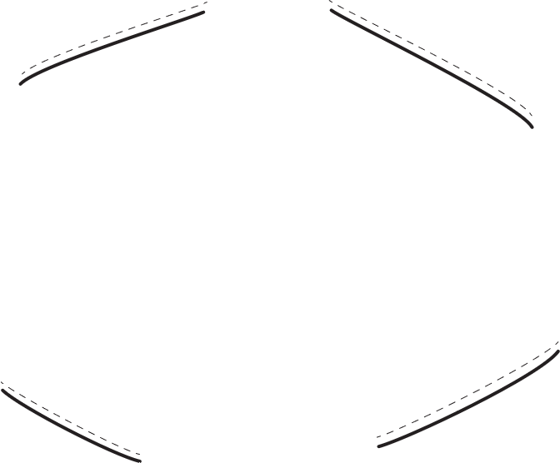
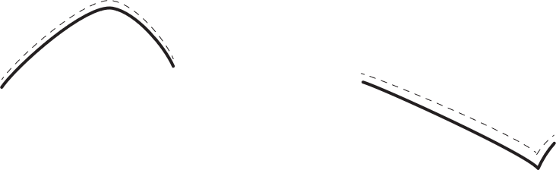
Example of design features for different fabrics
e.g. Stretch or non stretch
Light, mid or heavy weight
...
Yellow Example
Waist 3
Thigh zip pocket left:
Size 20 cm wide + 22 cm long
Shaped knee
Violet Example
Waist 3
Hand pockets round
Thigh zip pocket right: Size 18 cm wide + 20 cm long
Shaped knee
Design seams : knee
Reinforcement: hem
Extra feature: Cording in hem
P
Pattern
Pattern pieces
Main:
Waistband
Front pants
Backpants
Customer features:
Thigh pocket
P
Pattern
Pattern pieces
Main:
Waistband
Upper front pants
Lower front part
backpants
Customer features:
Hand pockets
Thigh pocket
Knee design seams
Hem reinforcement

